Slide 1
NETWORKS
A network is a set of devices (often referred to as nodes) connected by communication links.
A node can be a computer, printer, or any other device capable of sending and/or receiving data generated by other nodes on the network.

Slide 2
ADVANTAGES OF NETWORKS
Resource Sharing ( File , Application or Software )
Improved Communication
Reliability
Increased Storage Capacity
DISADVANTAGES OF NETWORKS
Security Issues
Hardware , Software set up cost

Slide 3
DATA COMMUNICATIONS CHARACTERISTICS
1.Delivery- Proper destination
2.Accuracy- Unaltered
3.Timeliness- On time
4.Jitter- uneven delay

Slide 4
DATA COMMUNICATIONS
The term telecommunication means communication at a distance.
The word data refers to information e.g) text, audio, video,image
Data communications are the exchange of data between two devices via some form of transmission medium such as a wire cable.

Slide 5
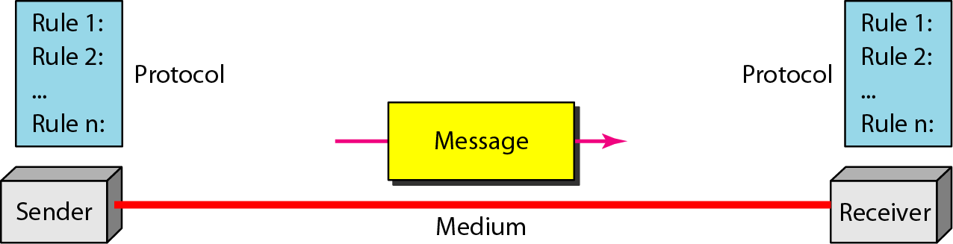
Five components of data communication

Slide 6
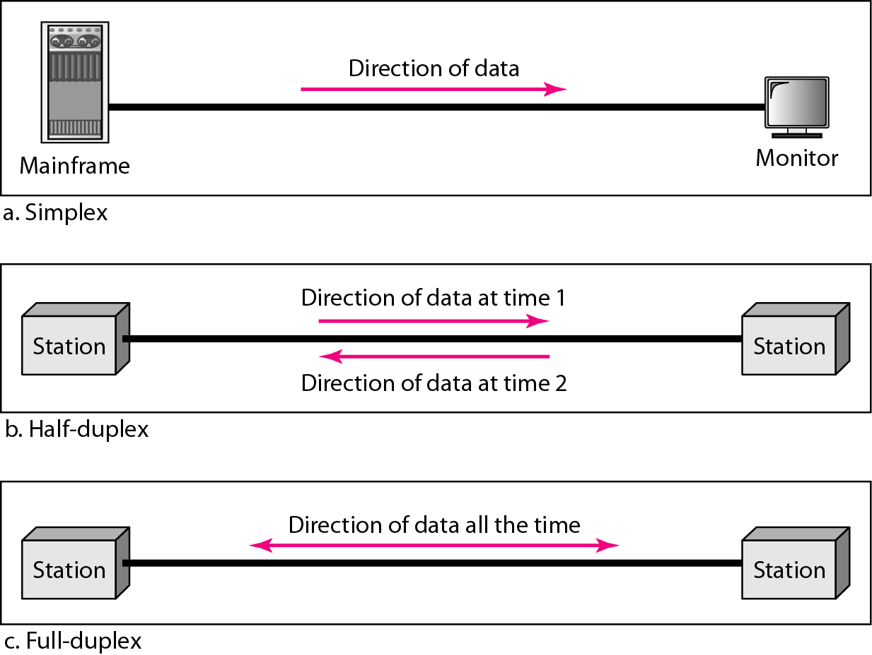
Data flow (simplex, half-duplex, and full-duplex)

Slide 7
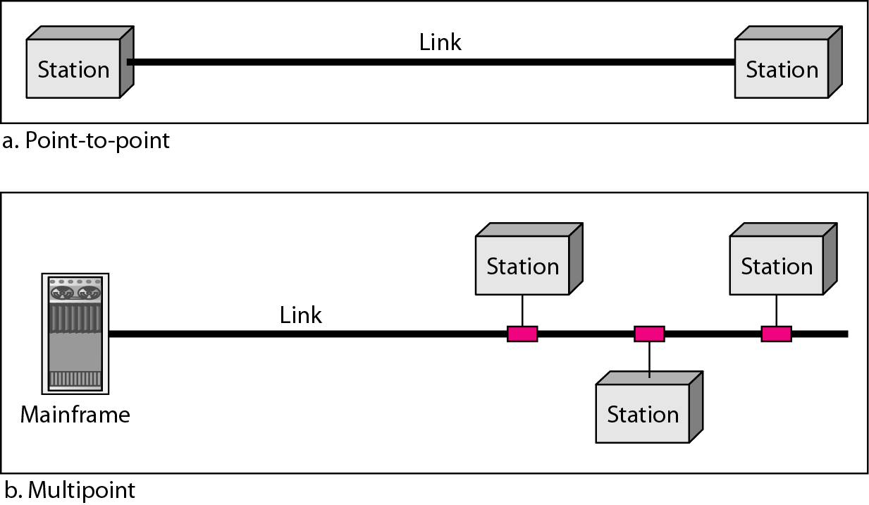
Types of connections: point-to-point and multipoint

Slide 8
CLASSIFICATIONS OF NETWORKS
Based on the geographial Distance - LAN,WAN,MAN,PAN
Based on Topolgy – Star , Ring , Bus , Tree , Mesh
Based on internal operations – Open Network or Closed Network

Slide 9
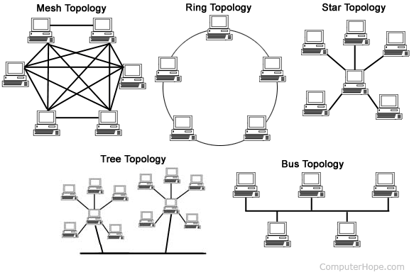
Categories of Networks – Based on topology

Slide 10
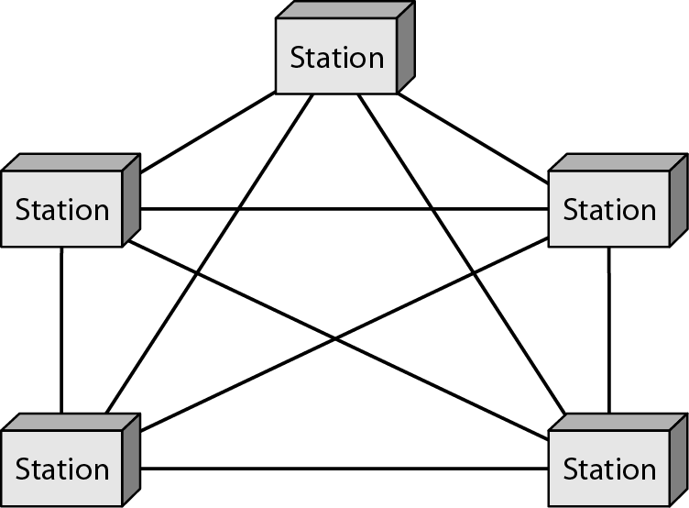
A fully connected mesh topology (five devices)
All the computers are interconnected.

Slide 11
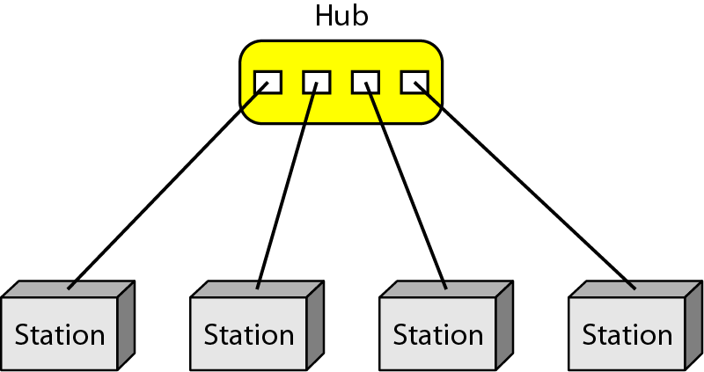
A star topology connecting four stations
All the nodes connected to a central node .
Node can be called as station or workstation or computers

Slide 12
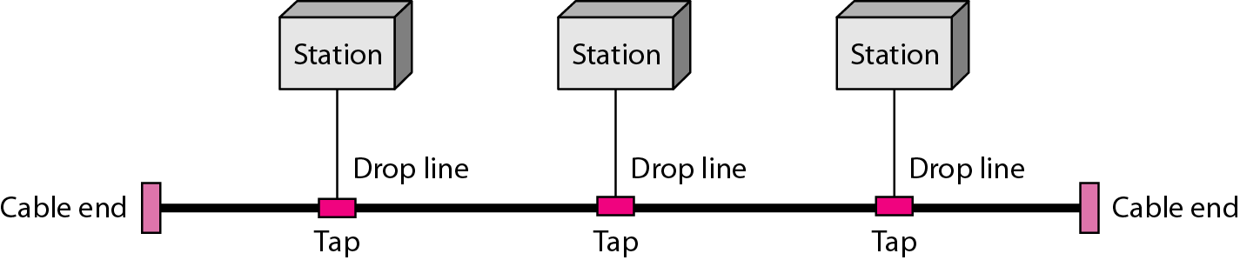
A bus topology connecting three stations
Bus Topology – Nodes are connected with cables in linear manner.

Slide 13
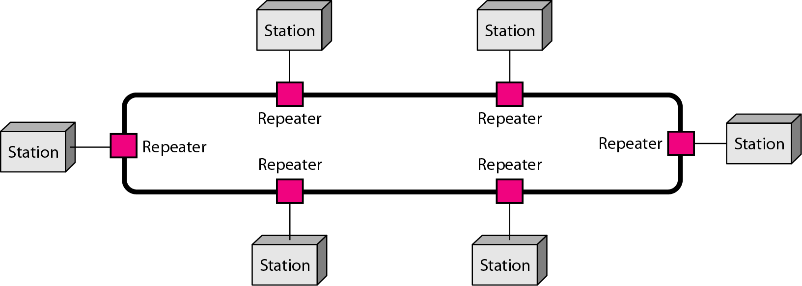
A ring topology connecting six stations
A node connected to exactly two neighboring nodes.

Slide 14
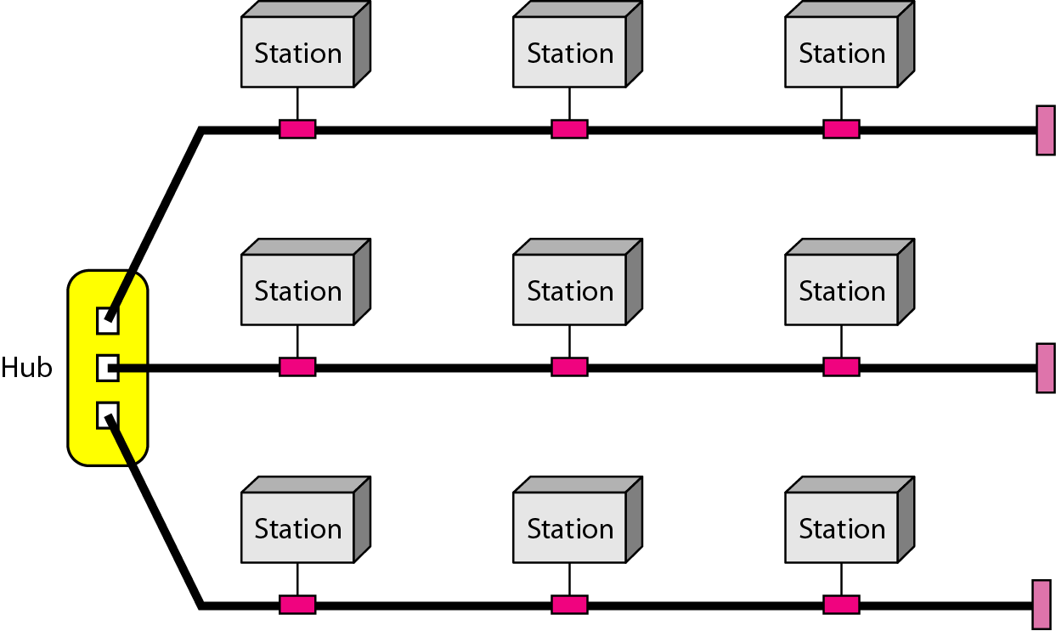
A hybrid topology: a star backbone with three bus networks

Slide 15
Categories of Networks- Based on Distance
Local Area Networks(LAN)- few kilometers e.g) campus
Wide Area Networks (WAN)- long distance e.g) country
Metropolitan Area Networks (MAN)- Between LAN and WAN e.g)city
Internetworks- Networks of networks
Personal Area Networks – Within a range of individual person

Slide 16
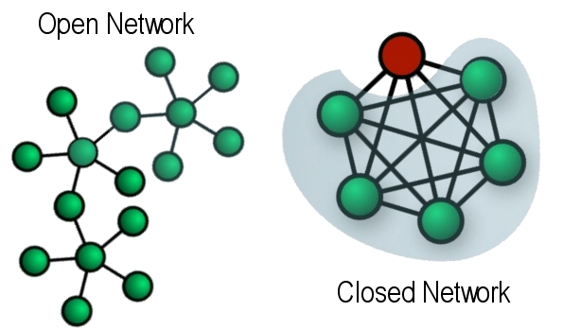
Categories of Networks- Based on Proprieatory
Open Network – A network that conforms to industry standard. Ex : Internet
Closed Network – A Network Controlled by individual or corporation which is secured and prohibited from unauthorized users.

Slide 17
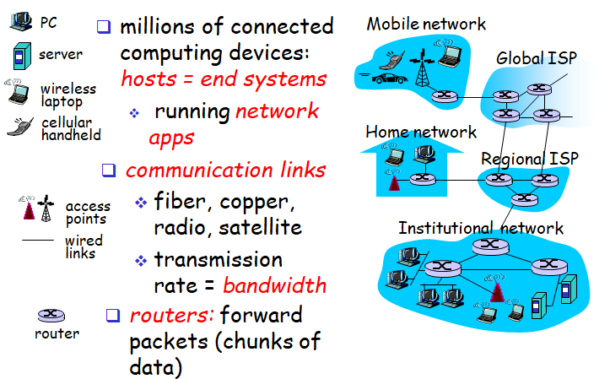
Hierarchical organization of the Internet

Slide 18
PROTOCOLS AND STANDARDS
Protocol – Description of message formats and the rules that two or more machines must follow to exchange messages.
All communication activity in Internet governed by protocols
HTTP – Hypertext transfer Protocol
FTP – File Transfer Protocol
TCP / IP – Transmission control protocol / Internet Protocol
SMTP – Simple Mail Transfer Protocol

Slide 19
Protocol elements :
Syntax: Format of data
Semantics: Meaning of each bits
Timing: When and at what time to send data

Slide 20
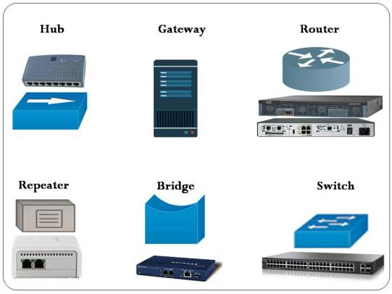
Networking Devices
Hub – Connects several computers together.
Switch – Similar to HUB which connects computers to form a LAN. Operates faster than HUB
Bridge – Links two LAN together of same protocols standard but with different cables
Repeater – Amplifies signals for long distance transmission
Router - Links two LAN together of different protocols standard . Divides network into two or more sub networks. Sends data across different networks like LAN and WAN.
Gateway – It is a device that connects dissimilar networks

Slide 21
Other Network Devices
MODEM – Converts digital signal to analog data and viveversa
Wi-Fi card – Wi-Fi cards are small and portable cards that allow your desktop or laptop computer to connect to the internet through a wireless network.
Access Points - separate network devices with a built-in antenna, transmitter and adapter.
APs use the wireless infrastructure network mode to provide a connection point between WLANs and a wired Ethernet LAN.
Brouter – Consolidates the functionalities of router and Bridge

